Slide 1
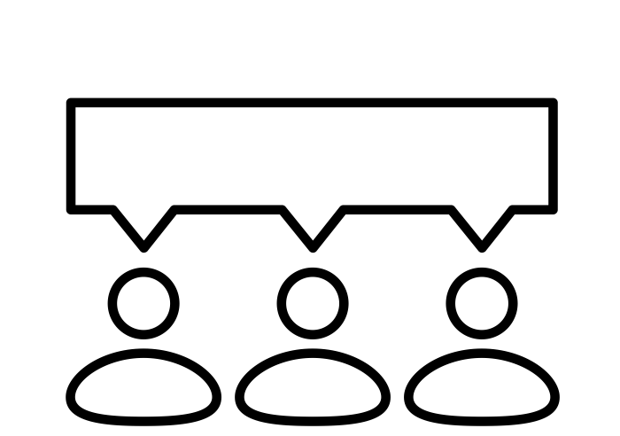
Infrared Camera
Sensing System
Based on Artificial Intelligence
INTERIM ANNOUNCEMENT
- 인공지능기반의 적외선 카메라 센싱 시스템 -
20192 Capstone Design Project 1 - Team7

Slide 2
Contents
001
Overview
003
Implement
Identify Necessity
Our Project
Development
Problem
002
Function
004
Effect
Requirements Analysis
Use-case Diagram
Architecture
Merits
Expected Effect
005
Future Schedule
Schedule
Future Task

Slide 3
Team7 - Infrared Camera Sensing System Based on Artificial Intelligence
Overview
Identify Necessity
001
Overview
Identify Necessity
Our Project
Our Project

Slide 4


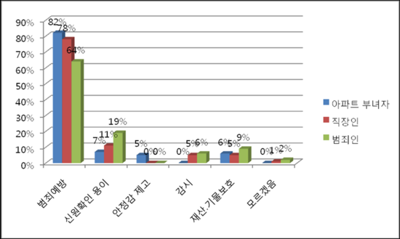
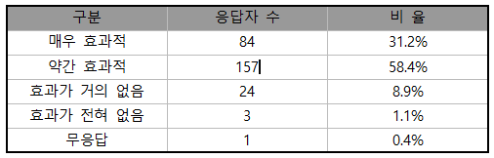
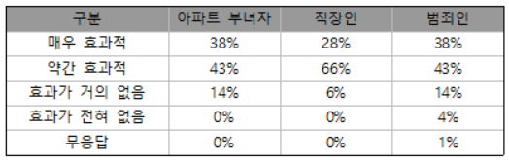
Team7 - Infrared Camera Sensing System Based on Artificial Intelligence
1
Identify Necessity
Overview
“CCTV is an efficient way to prevent various crimes.”
Identify Necessity
Our Project
<CCTV의 효과성에 대한 인식>
<CCTV 설치목적에 대한 응답 대상 집단별 인식>
<CCTV의 효과성에 대한 집단별 인식>

Slide 5
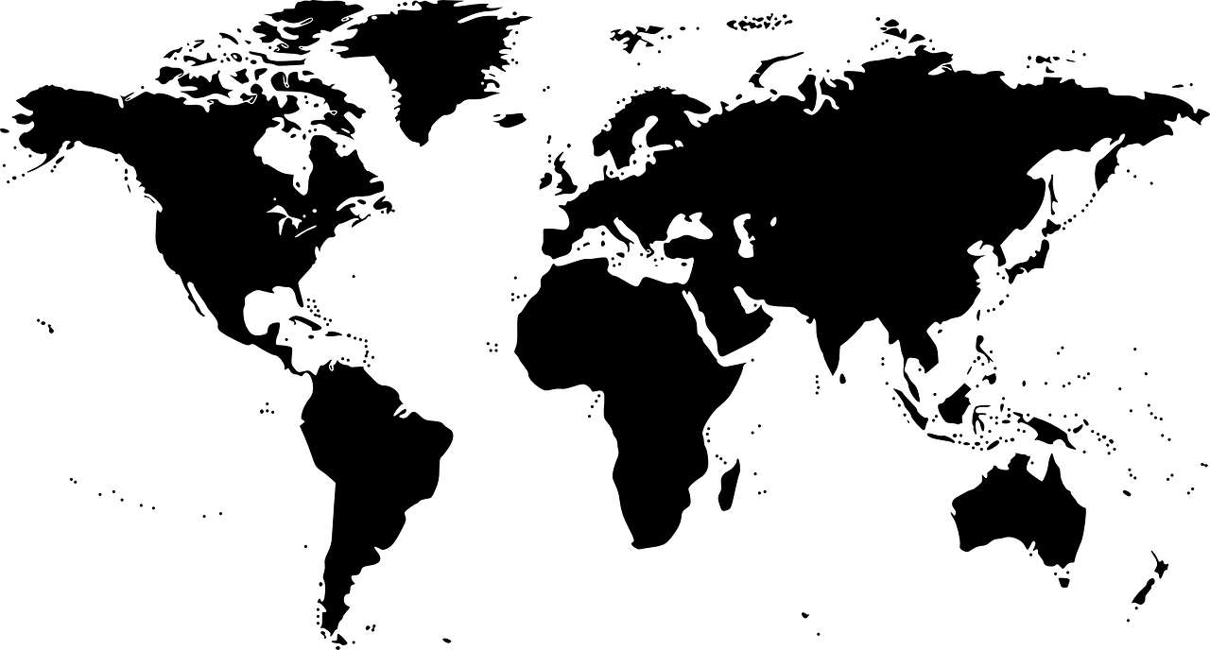
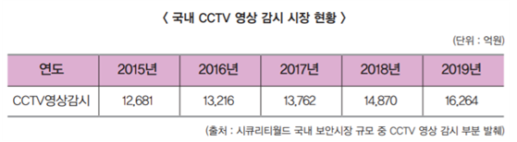
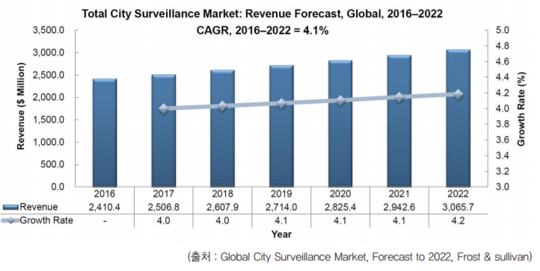
Team7 - Infrared Camera Sensing System Based on Artificial Intelligence
1
Identify Necessity
Overview
An expansion of the Video Surveillance Market
Identify Necessity
1.8
5.2
6.3
28.8
3.5
3.5
Our Project
<Global CCTV Market>
Notes:
세계 cctv 핫한 시장 – 중국 > 미국 > 스웨덴 > 일본 > 한국 > 캐나다 … (중국산업전망에서 발췌)

Slide 6

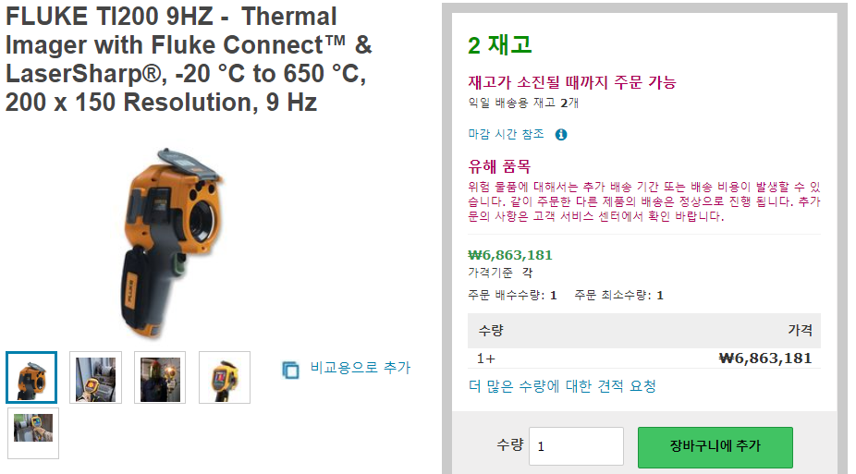
Team7 - Infrared Camera Sensing System Based on Artificial Intelligence
1
Identify Necessity
Overview
“But High-Performance CCTV are expensive!”
Identify Necessity
Our Project
<Expensive Infrared Camera>

Slide 7
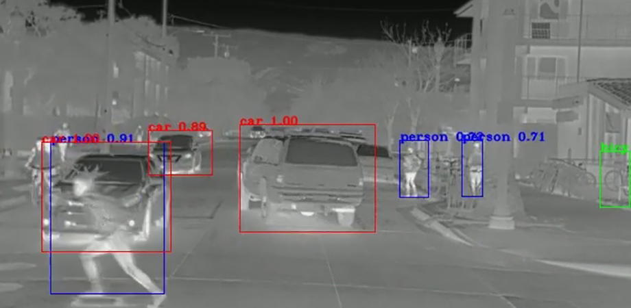
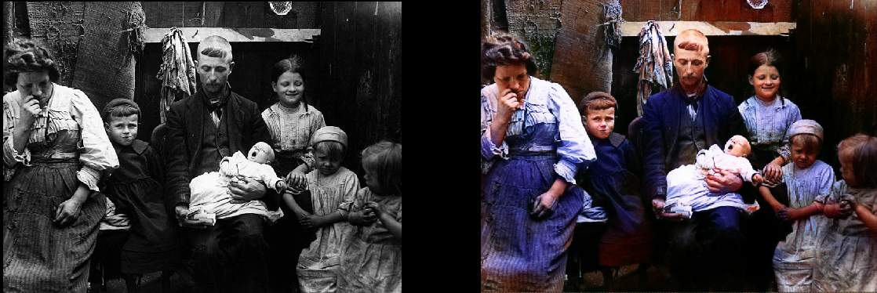
Team7 - Infrared Camera Sensing System Based on Artificial Intelligence
1
Our Project
Overview
Infrared Camera Sensing System Based on Artificial Intelligence
Identify Necessity
Object Recognition
Intent Classification
Camera Control
Change Monochrome Photo to Color Photo
Our Project

Slide 8
Team7 - Infrared Camera Sensing System Based on Artificial Intelligence
Design
Requirements
002
Function
Requirements Analysis
Use-case Diagram
Architecture
Use-case Diagram
Architecture

Slide 9


Team7 - Infrared Camera Sensing System Based on Artificial Intelligence
2
Requirement Analysis
Design
Object Detect(★ ★ ★)
Requirements
→ Object Detection through YOLO(Done)
Use-case Diagram
Camera Quality Improvement(★★)
→ BW coloring through GAN (Done)
Architecture

Slide 10
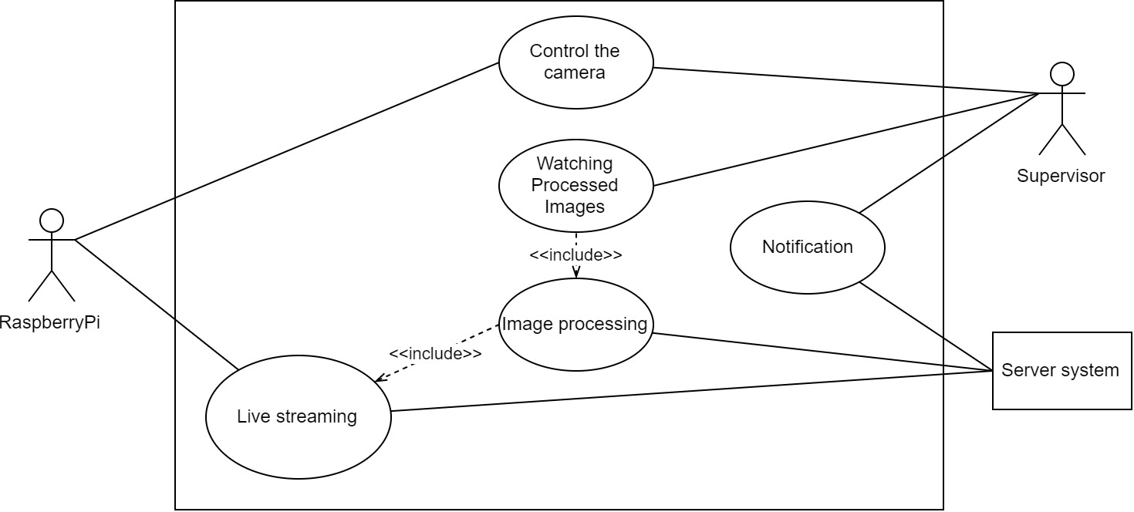
Team7 - Infrared Camera Sensing System Based on Artificial Intelligence
2
Use-case Diagram
Design
Requirements
Use-case Diagram
Architecture

Slide 11
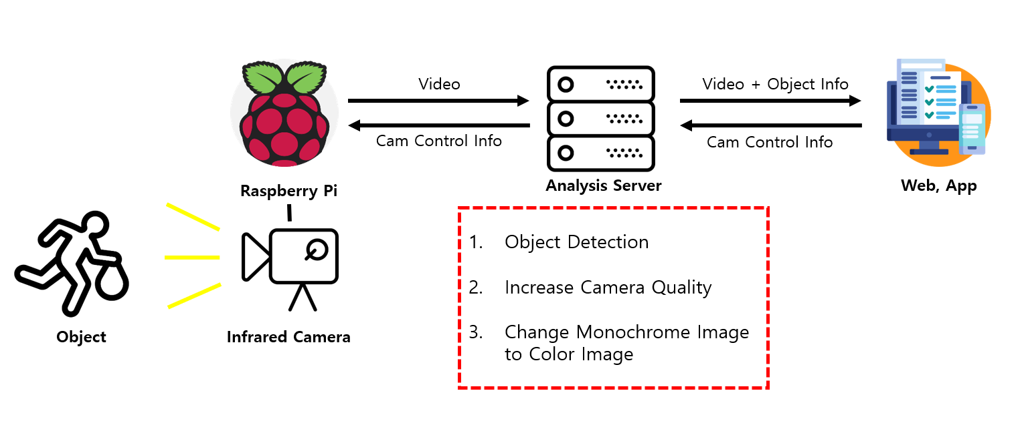
Team7 - Infrared Camera Sensing System Based on Artificial Intelligence
2
Architecture
Overview
Requirements
Use-case Diagram
Architecture
Notes:
* Overview 최신화 시키기

Slide 12
Team7 - Infrared Camera Sensing System Based on Artificial Intelligence
Implement
Development
003
Implement
Development
Problem
Problem

Slide 13
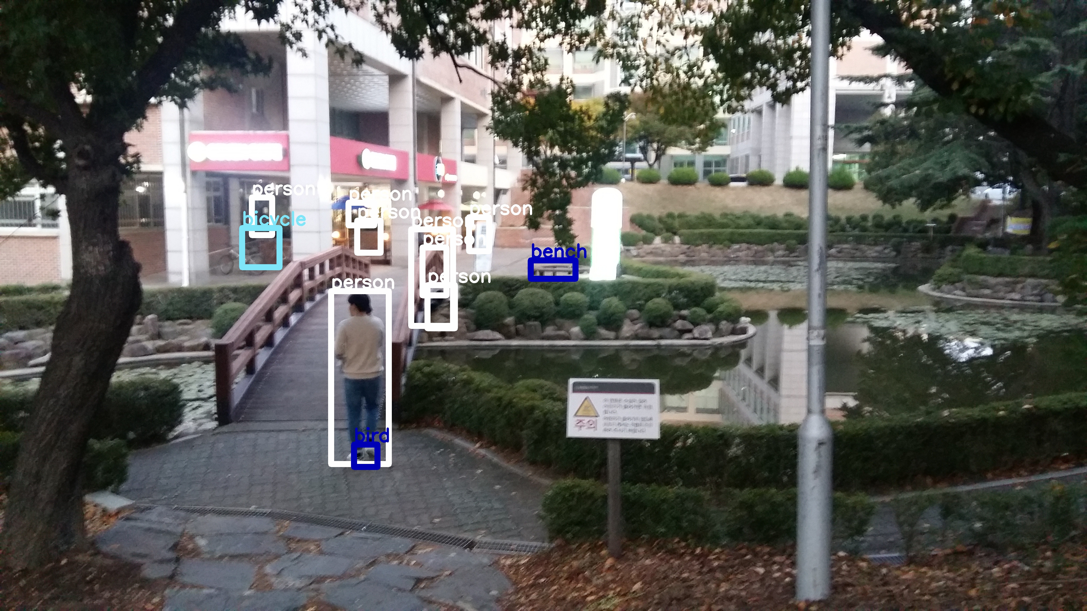
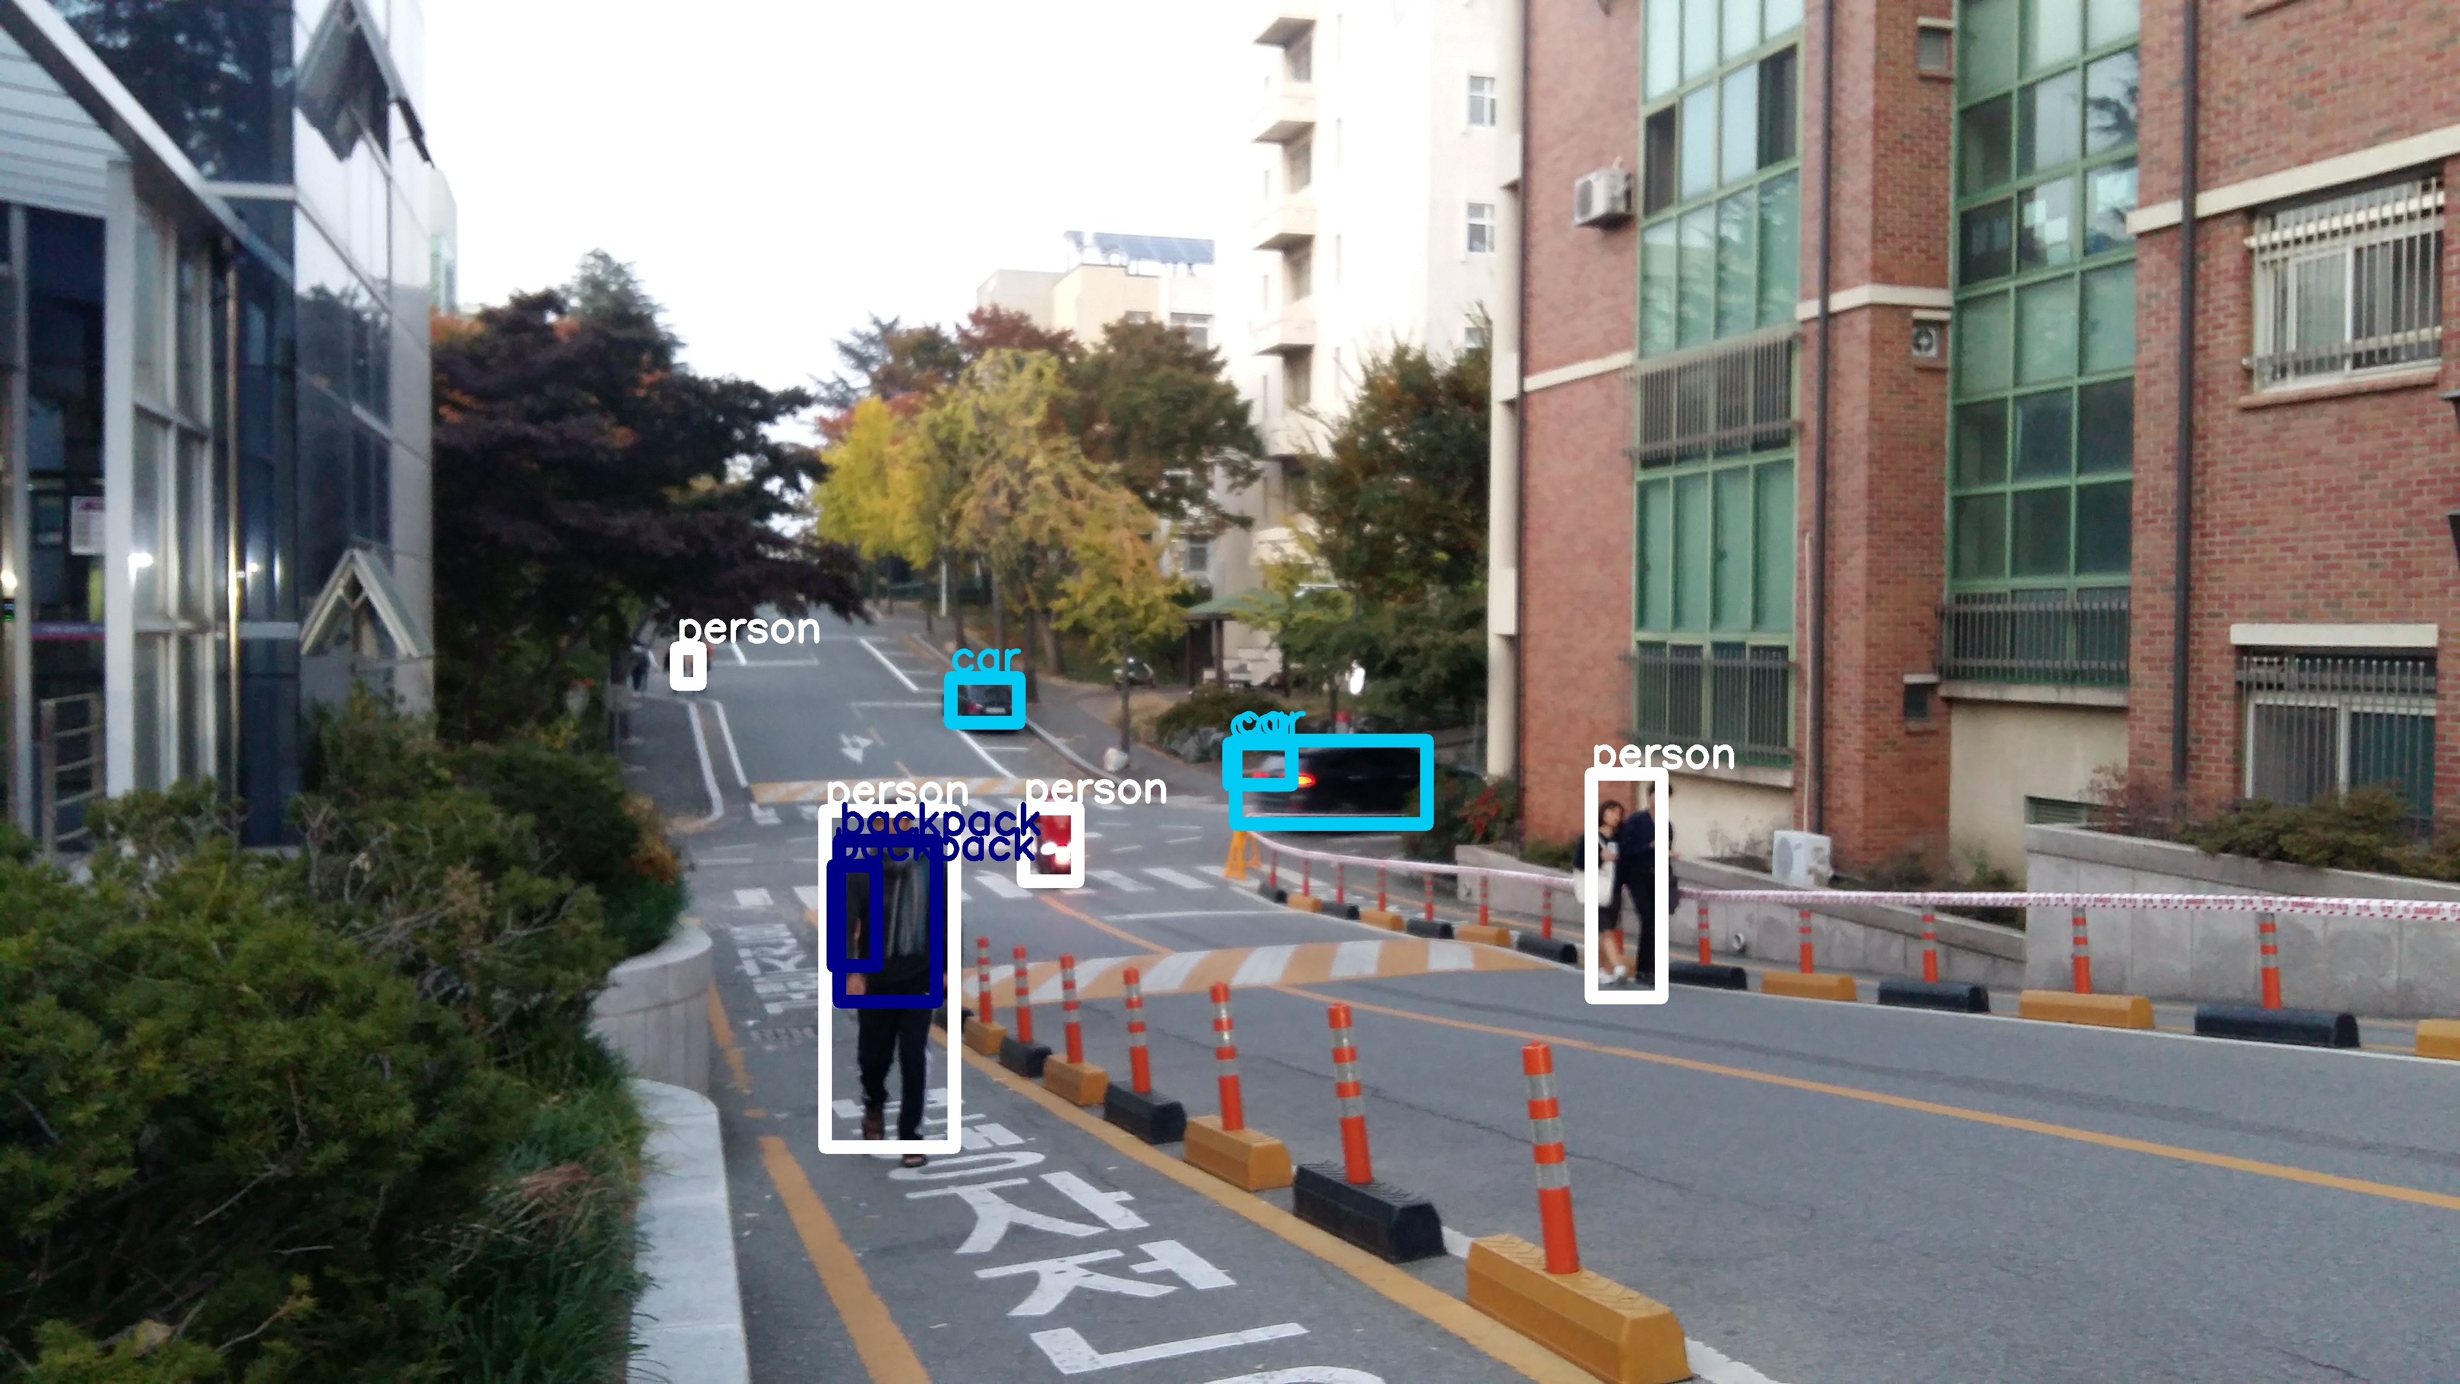
Team7 - Infrared Camera Sensing System Based on Artificial Intelligence
3
Development – Object Detection
Implement
Development
Problem

Slide 14
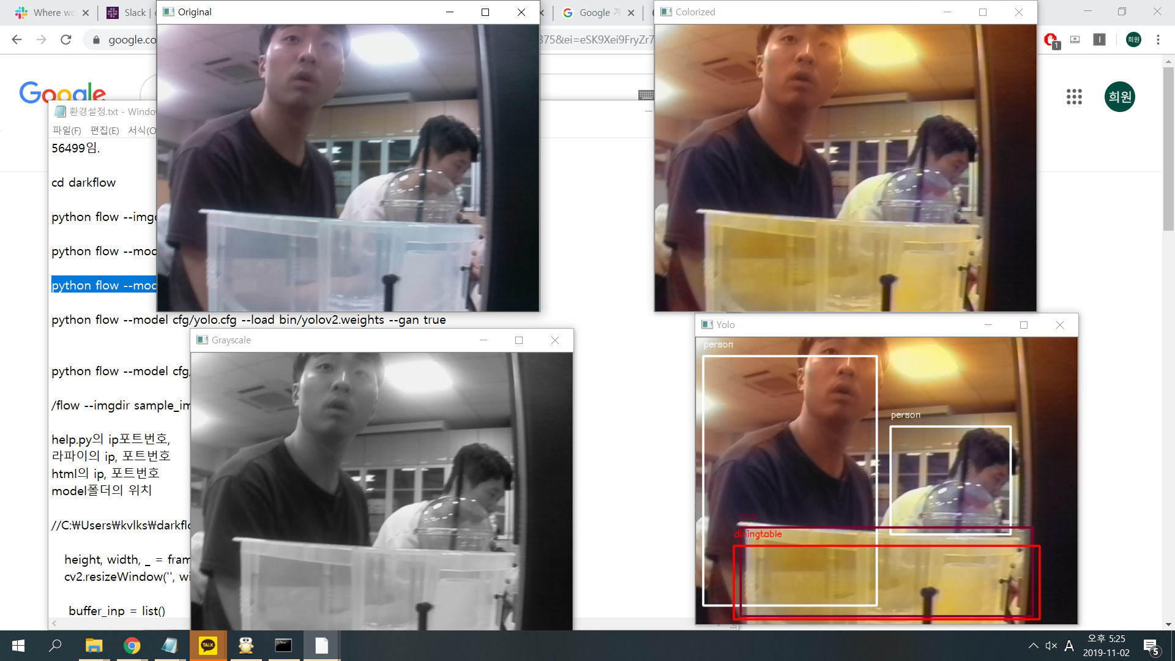
Team7 - Infrared Camera Sensing System Based on Artificial Intelligence
3
Development – GAN
Implement
Development
Problem

Slide 15
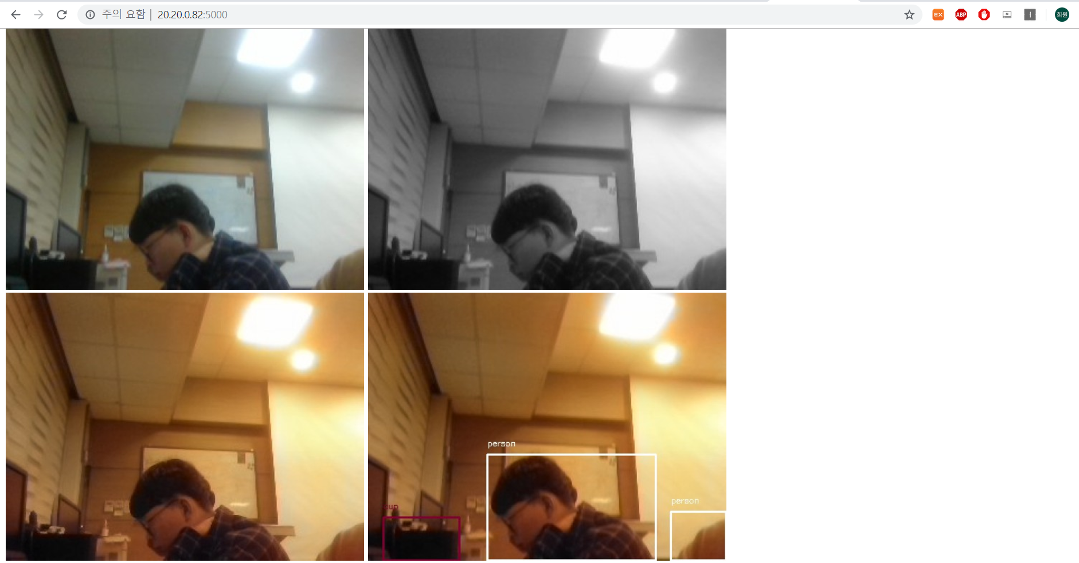
Team7 - Infrared Camera Sensing System Based on Artificial Intelligence
3
Development – Web Page
Implement
Development
Problem

Slide 16
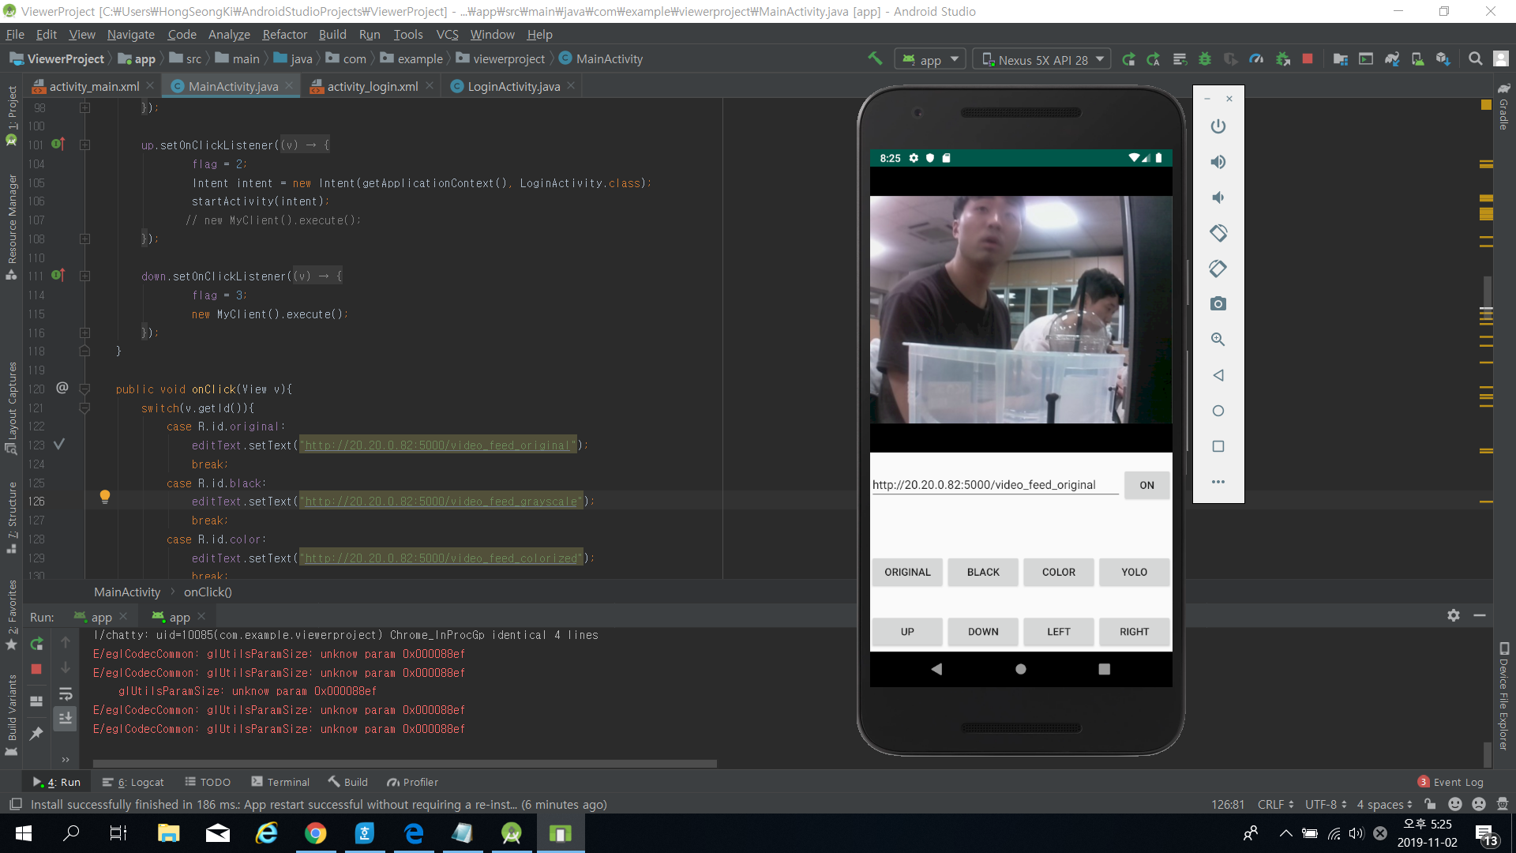
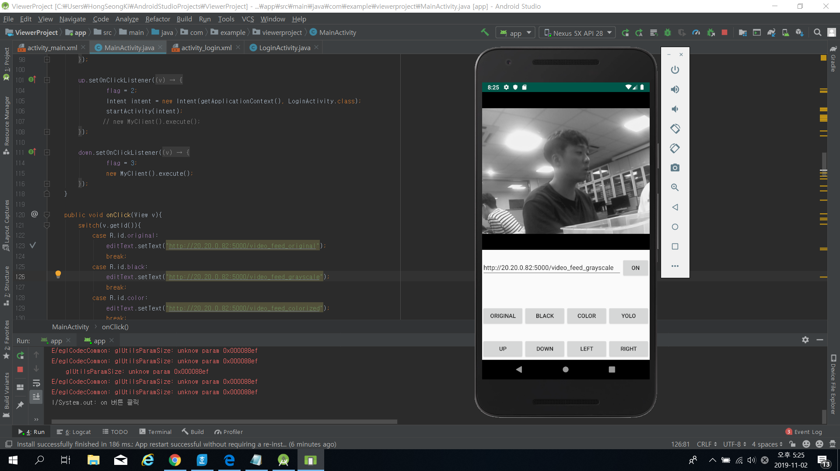
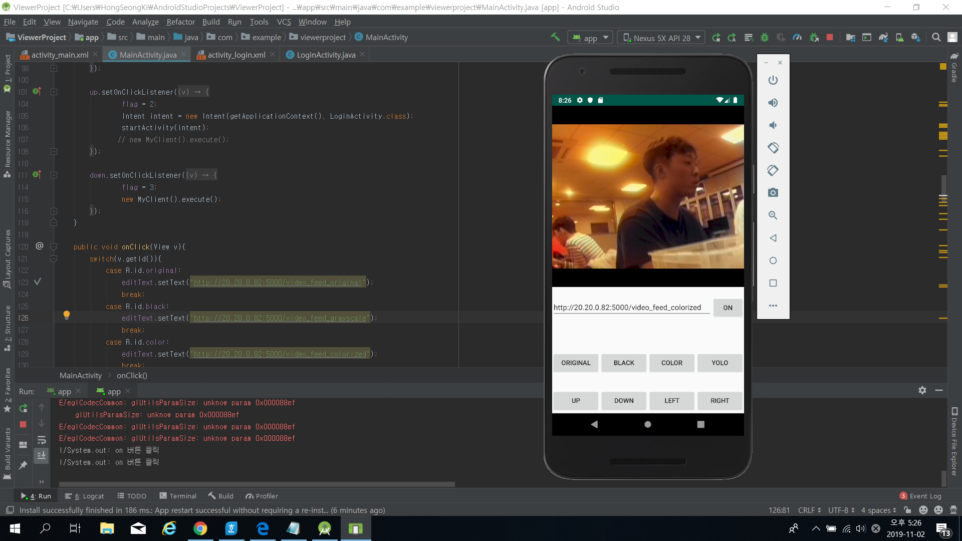
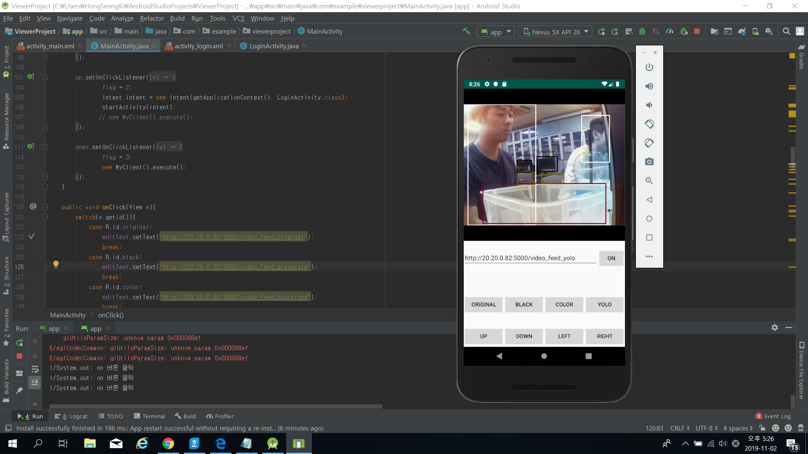
Team7 - Infrared Camera Sensing System Based on Artificial Intelligence
3
Development – App
Implement
Original
Grayscale
Colorized
YOLO
Development
Problem

Slide 17


Team7 - Infrared Camera Sensing System Based on Artificial Intelligence
3
Problem
Future Schedule
Development
Slow Speed through Computer Performance
Problem
Slow Communication Speed
Notes:
컴퓨터 성능으로 인한 느린 속도
통신 속도의 저하

Slide 18
Team7 - Infrared Camera Sensing System Based on Artificial Intelligence
Effect
Merits
004
Effect
Merits
Expected Effect
Expected Effect

Slide 19
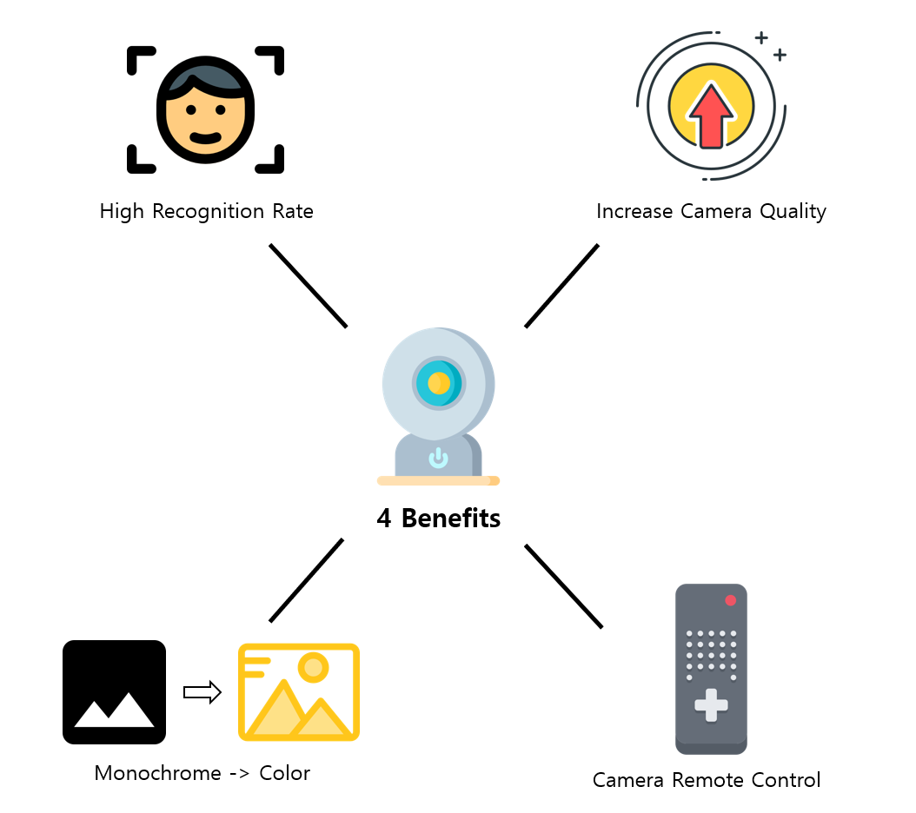
Team7 - Infrared Camera Sensing System Based on Artificial Intelligence
4
Merits
Effect
Merits
Expected Effect

Slide 20
Team7 - Infrared Camera Sensing System Based on Artificial Intelligence
4
Merits
Effect
Merits
Automatic Recognition
Effective Observation
Expected Effect
Innovative CCTV
High Quality Streaming
Notes:
활용방안
- 기존의 CCTV와 달리 자체적으로 물체를 인식하고 의도를 파악할 수 있는 차세대 CCTV를 제공한다.
- 적외선 카메라를 통한 효율적인 야간 감시 및 야생동물 관측을 할 수 있다.
- 실시간 고성능 스트리밍을 제공할 수 있다.

Slide 21


Team7 - Infrared Camera Sensing System Based on Artificial Intelligence
4
Expected Effect
Effect
Economic Advantage
Merits
Good performance with low-cost cameras
Expected Effect
Security Advantage
Better recognize objects at night
Notes:
활용방안
- 기존의 CCTV와 달리 자체적으로 물체를 인식하고 의도를 파악할 수 있는 차세대 CCTV를 제공한다.
- 적외선 카메라를 통한 효율적인 야간 감시 및 야생동물 관측을 할 수 있다.
- 실시간 고성능 스트리밍을 제공할 수 있다.

Slide 22
Team7 - Infrared Camera Sensing System Based on Artificial Intelligence
4
Expected Effect
Effect
Security Advantage
Merits
Better recognize objects at night
Expected Effect
Economic Advantage
Good performance with low-cost cameras
Notes:
활용방안
- 기존의 CCTV와 달리 자체적으로 물체를 인식하고 의도를 파악할 수 있는 차세대 CCTV를 제공한다.
- 적외선 카메라를 통한 효율적인 야간 감시 및 야생동물 관측을 할 수 있다.
- 실시간 고성능 스트리밍을 제공할 수 있다.

Slide 23
Team7 - Infrared Camera Sensing System Based on Artificial Intelligence
Future Schedule
Schedule
005
Future Schedule
Schedule
Future Task
Future Task

Slide 24
Team7 - Infrared Camera Sensing System Based on Artificial Intelligence
5
Schedule
Future Schedule
Detail Schedule.
Sep, week 1 | Topic Selection, Mentor Meeting | Nov, week 1 | Feedback, Prepare Interim Announcement
 | 9/2 Team Meeting, 9/5 Mentor Meeting |  | 11/3 Team Meeting, 11/4 Interim Announcement
Sep, week 2 | System Requirements, Identify Problem | Nov, week 2 | Paper, Review & Additional Development
 | 9/8 Team Meeting, 9/9 1st Presentation |  | 11/10 Team Meeting
Sep, week 3 | System Requirements, Market & Technical Survey | Nov, week 3 | Finish Paper, Review & Additional Development
 | 9/15 Team Meeting, 9/1 2nd Presentation |  | 11/17 Team Meeting, 11/22 Submit Paper(All)
Sep, week 4 | Background Knowledge, Specific Requirements | Nov, week 4 | System Document, Review & Development
 | 9/22 Team Meeting |  | 11/24 Team Meeting
Oct, week 1 | System Structured, Requirements Analysis | Dec, week 1 | System Document, Prepare Final Presentation
 | 9/29 Team Meeting |  | 12/1 Team Meeting, 12/3 Final Presentation
Oct, week 2 | Software Design, Specific design | Dec, week 2 | Finish Implementation
 | 10/6 Team Meeting |  | 12/8 Team Meeting
Oct, week 3 | Development | Dec, week 3 | Finish Project, System Registration
 | 10/13 Team Meeting |  | 12/15 Team Meeting, 12/X Submit Final Document
Oct, week 5 | Development, Verification & Reviews
 | 10/27 Team Meeting, 11/1 Submit Paper(Summary)
Schedule
Future Task

Slide 25
Team7 - Infrared Camera Sensing System Based on Artificial Intelligence
5
Schedule
Future Schedule
September
Planning
Analysis
Design
Implement
Schedule
October
Implement
Feedback
Paper
Future Task
November
Feedback
Paper
Announcement

Slide 26





Team7 - Infrared Camera Sensing System Based on Artificial Intelligence
5
Future Task
Future Schedule
Completion Paper, Obtain Copyright
Schedule
Android & Web Design
Improve Performance though Tensor GPU
Future Task
Camera Control
Test in a variety of cases
Camera Control
Notes:
다양한 환경에서 진행되는 지 확인 추가

Slide 27




Team7 - Infrared Camera Sensing System Based on Artificial Intelligence
5
Future Task
Future Schedule
Paper (In Progress)
Schedule
Future Task
SW Copyright (Scheduled)

Slide 28
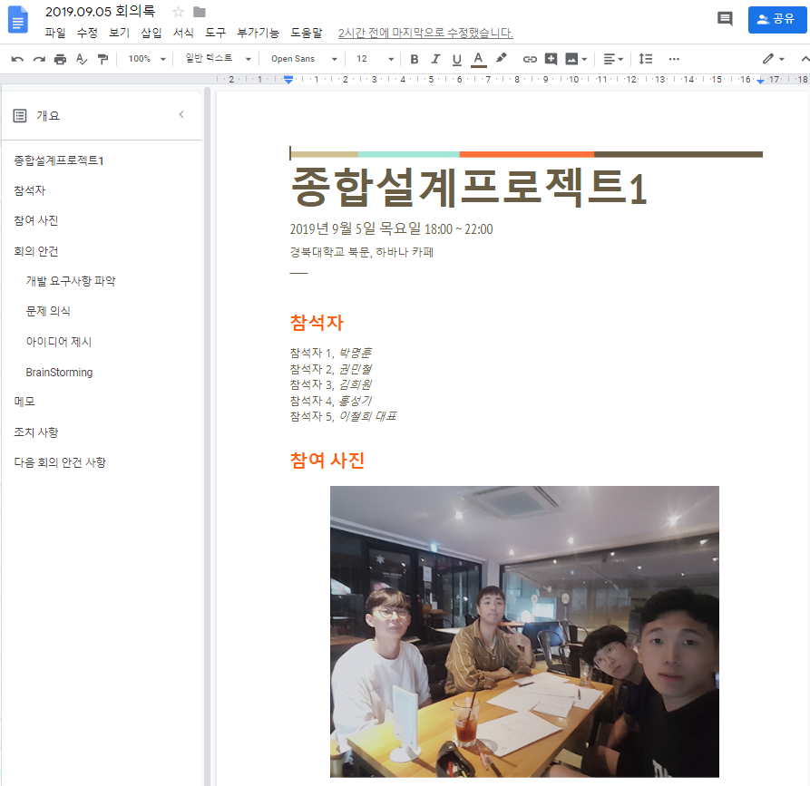
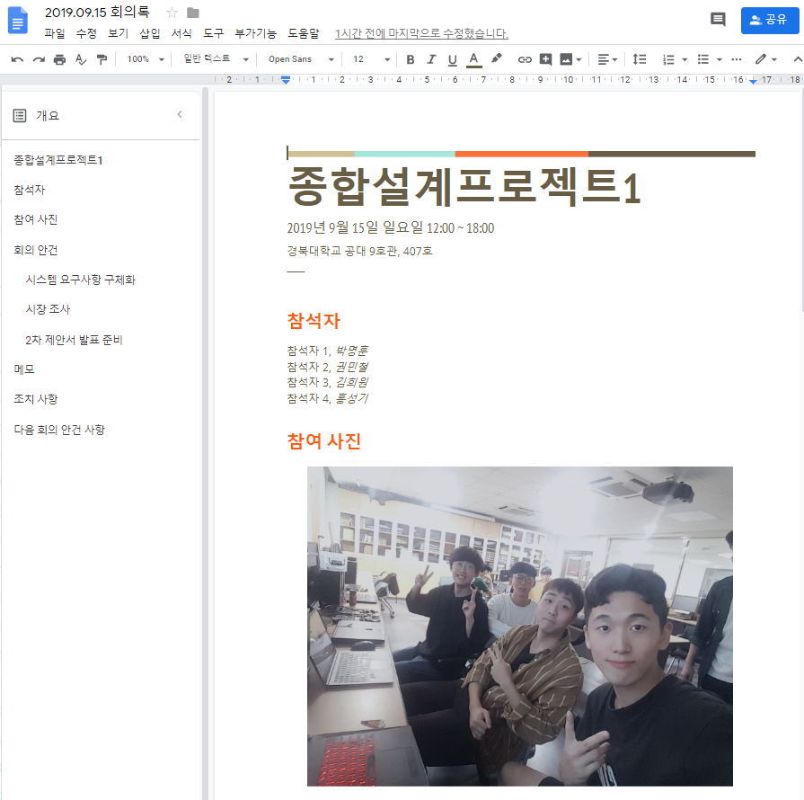
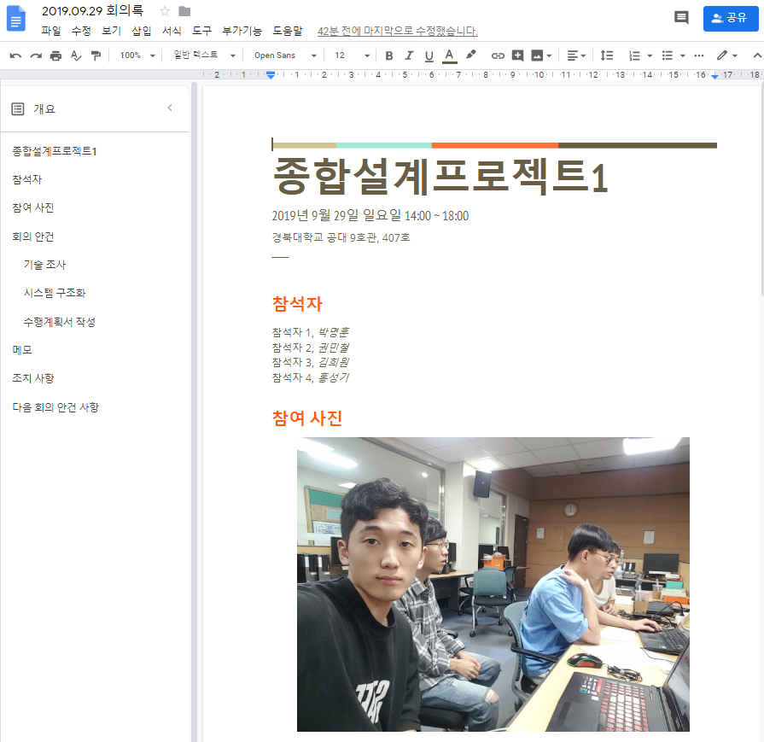
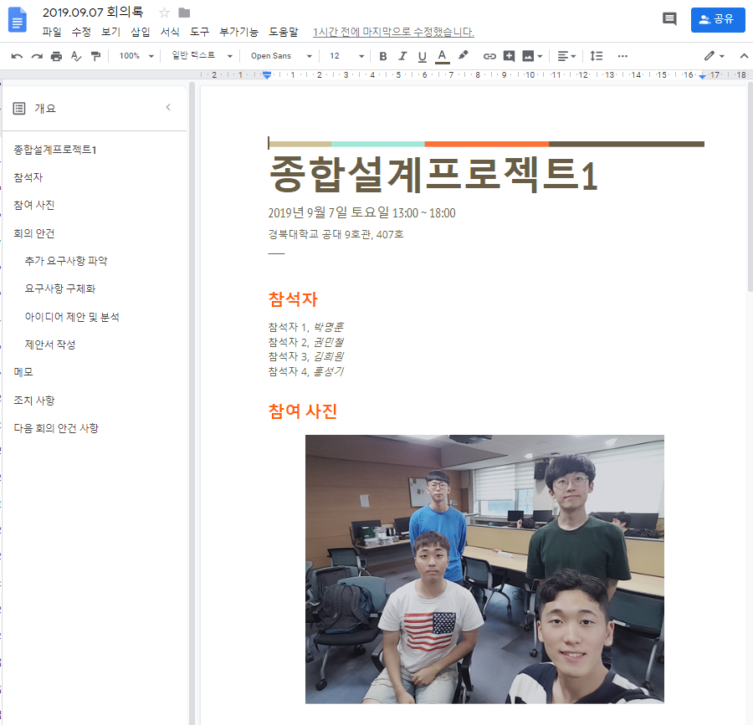
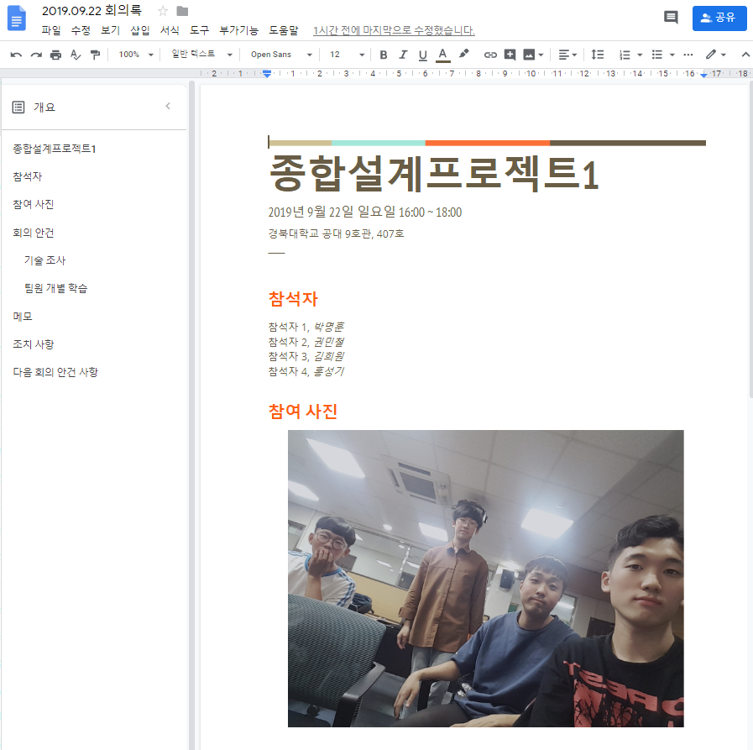
Team7 - Infrared Camera Sensing System Based on Artificial Intelligence
*
Meeting Minutes
*
Meeting Minutes
Notes:
어떻게 고칠 것인지.
1. 소프트웨어 저작권 신청 완료
2. 성능 향상 방안 제안
3. 통신 원활

Slide 29
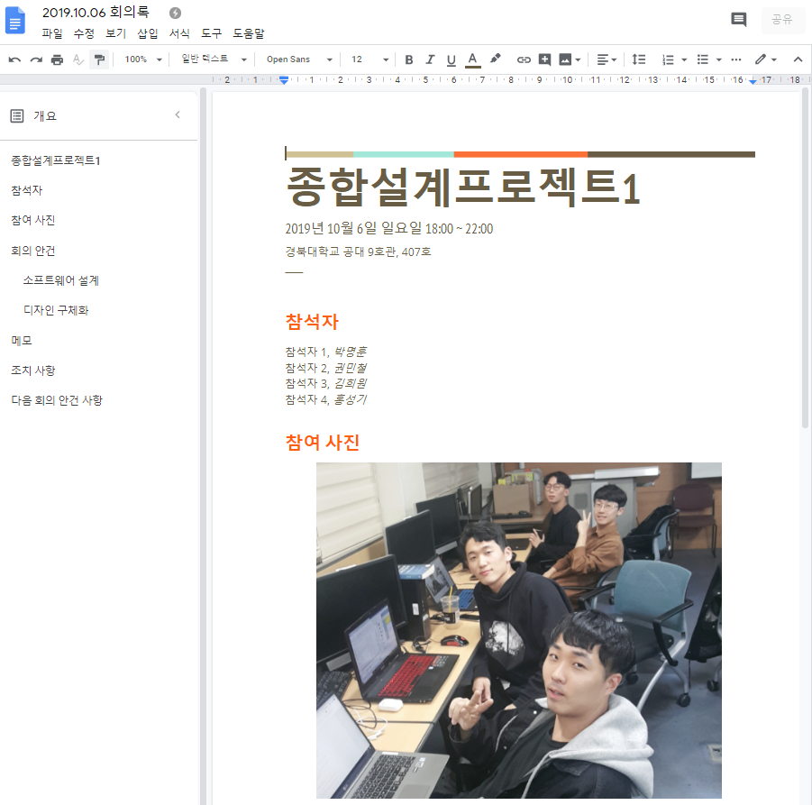
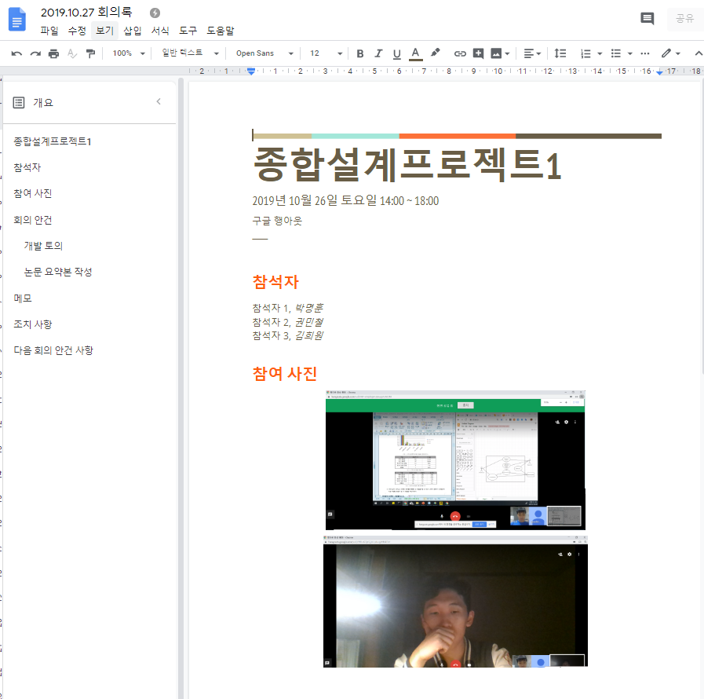
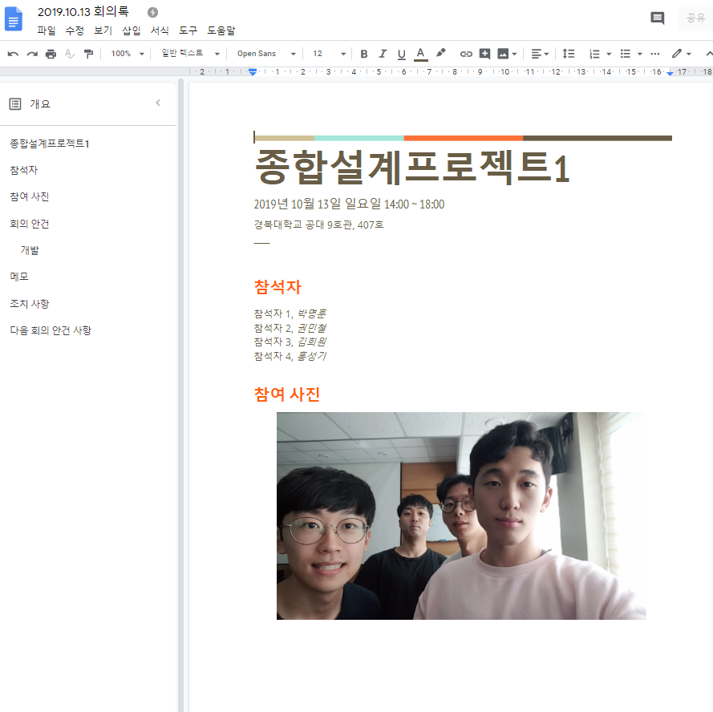
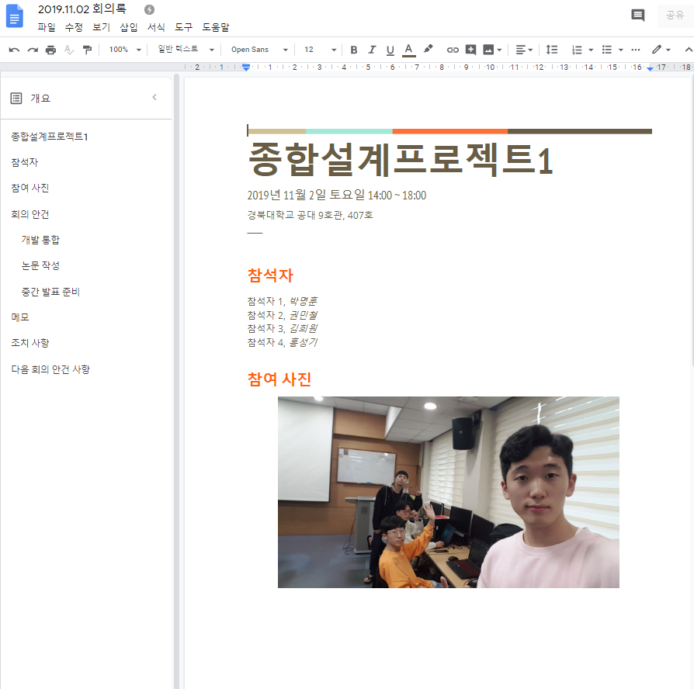
Team7 - Infrared Camera Sensing System Based on Artificial Intelligence
*
Meeting Minutes
*
Meeting Minutes
Notes:
어떻게 고칠 것인지.
1. 소프트웨어 저작권 신청 완료
2. 성능 향상 방안 제안
3. 통신 원활

Slide 30

Team7 - Infrared Camera Sensing System Based on Artificial Intelligence
*
Q & A
Thank You!
Notes:
어떻게 고칠 것인지.
1. 소프트웨어 저작권 신청 완료
2. 성능 향상 방안 제안
3. 통신 원활

